Slide 1
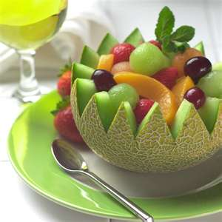
FOOD & CULTURE
ORIGINS OF EATING HABITS

Slide 2
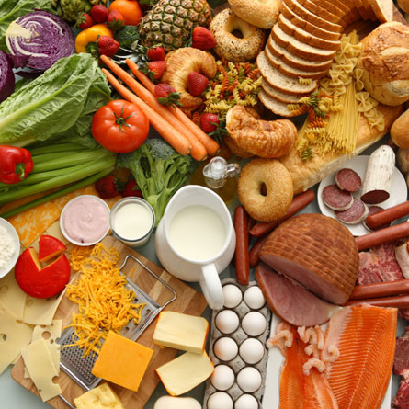
FOOD
DEFINED AS,
“ANY SUBSTANCE THAT PROVIDES NUTRIENTS NECESSARY TO MAINTAIN LIFE AND GROWTH WHEN INGESTED.”
FOOD IS A UNIVERSAL SIGN OF HOSPITALITY, SHARING OF FOOD SHOWS FRIENDSHIP, HOSPITALITY & ACCEPTANCE.

Slide 3
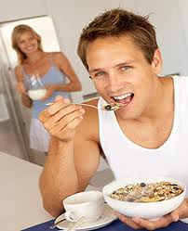
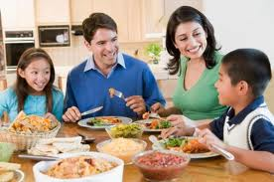
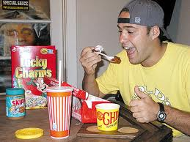
FOOD HABITS
THE WAY HUMANS USE FOOD
HOW IT IS…
SELECTED
OBTAINED
DISTRIBUTED
PREPARED
SERVED
EATEN

Slide 4
ACCULTURATION
WHEN INDIVIDUALS FROM ONE ETHNICITY MOVE TO AN AREA WITH DIFFERENT CULTURAL NORMS, THEY ADAPT TO THE MAJORITY.
REFLECTED IN ONE’S ATTITUDES AND BELIEFS
TYPICALLY FIRST GENERATION IMMIGRANTS RETAIN SOME CULTURAL PRACTICES

Slide 6
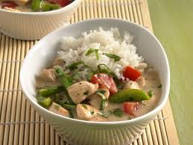
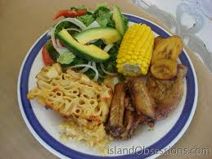
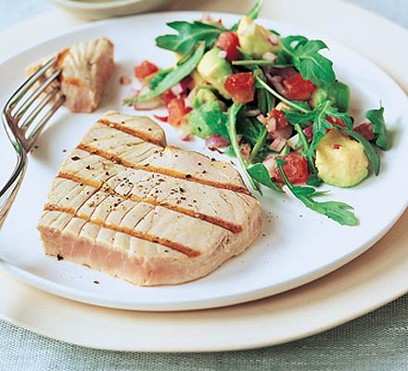
EXERCISE
WHAT IS A TYPICAL MEAL THAT IS PREPARED AT HOME?
CAN YOU TRACE ANY OF ITS ELEMENTS TO CULTURAL INFLUENCES?
HOW DO YOU MAKE FOOD CHOICES?
WHAT IS THE MOFT INFLUENTIAL DOMAIN?
SHARE YOUR RESPONSES!…….☺

Slide 7
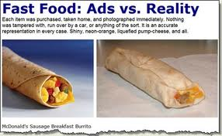
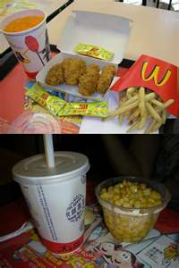
INFLUENCES
ETIQUETTE
RELIGIOUS BELIEFS
STIGMAS
ENVIRONMENT
LIFESTYLE
TECHNOLOGY
SOCIAL/PEERS
PRIORITIES
MEDIA
EMOTIONS
CULTURE
FAMILY
DIETARY LAWS-FOOD CHOICES PRACTICES BY A PARTICULAR CULTURE
EX: KOSHER FOOD

Slide 8
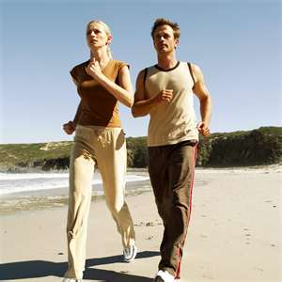
FOOD CONCEPTS
OMNIVORE’S PARADOX
CAN CONSUME WIDE SELECTION OF FOOD
BE FLEXIBLE YET CAUTIOUS
SELF-IDENTITY
“YOU ARE WHAT YOU EAT”
SYMBOLISM
EX: BREAD

Slide 9
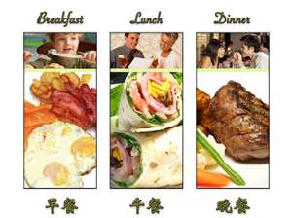
MEAL PATTERNS
ELEMENTS
SEQUENCE
FREQUENCY
PORTION SIZE
COMPANY
WHAT MEAL PATTERNS CAN YOU IDENTIFY AS AMERICANS? WHAT ARE SOME TEEN EATING PRACTICES?

Slide 10
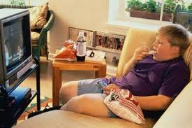
CULTURE
VALUES, CUSTOMS, TRADITIONS, BELIEFS, ATTITUDES, AND PRACTICES ACCEPTED BY A LARGE GROUP OR COMMUNITY
IT IS LEARNED AND INHERITED
BEHAVIOR PATTERNS ARE REINFORCED
CAN EVOLVE
CAN BE INHERENT TO A LOCATION
CULTURE CAN MEAN OUTSIDE OR NATIVE…..

Slide 11
CONSUMER FOOD CHOICE MODEL
EXPLAINS FATORS INFLUENCING INDIVIDUAL’S DECISIONS
SUPPORTS THE IDEA THAT FOOD IS PRIMARILY MOTIVATED BY TASTE

Slide 12
CONSUMER FOOD CHOICE MODEL
CHILDREN
COST
CONVENIENCE
TASTE
METABOLISM
FOOD CHOICE
SELF-EXPRESSION
VARIETY
WELL-BEING
ADULT
HEALTH OUTCOMES

Slide 13
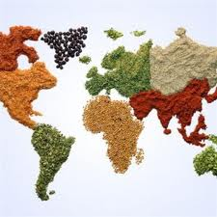
TERMS
CULTURE-COMMON BELIEFS, TRADITIONS OF A GROUP
ETHNIC-ASSOCIATED WITH A CULTURE
CUISINE-A CULTURE’S REPRESENTATIVE FOOD STYLES & PREPARATION
CUSTOM- AN ESTABLISHED PRACTICE REPEATED OVER TIME
FUSION-MIXING OF CULTURAL INFLUENCES
STAPLE-MOSTLY WIDELY PRODUCED AND EATEN FOOD
ETIQUETTE-RULES RELATED TO BEHAVIORS FOR SERVING AND EATING FOOD
DIVERSITY-A VARIED REPRESENTATION OF VARIOUS CULTURAL GROUPS (ALSO REFERRED TO AS MULTICULTURALISM)
GIVE AN EXAMPLE OF A FUSION AND A STAPLE FOOD.

Slide 14
SALAD BOWL OR MELTING POT?
WHAT IS THE CONTRAVERSY?
RETENTION
BLENDING
WHAT DOES FUSION CUISINE SUPPORT?
WHAT DOES ACCULTURATION SUPPORT?
GIVE AN EXAMPLE OF SALAD BOWL MENTALITY.

Slide 15
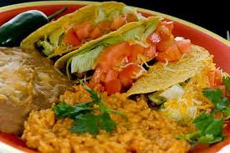
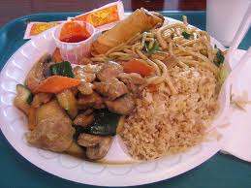
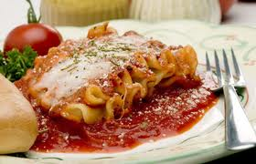
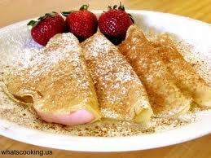
WHICH ONES CAN YOU IDENTIFY?

